Slide 1
VAE version of PointNet
Samarth Singh

Slide 2
Intro
PointNet allows for classification of 3d-point cloud structures
PyTorch implementation: https://github.com/fxia22/pointnet.pytorch
Goal – Produce a VAE model to generate new point-clouds

Slide 3
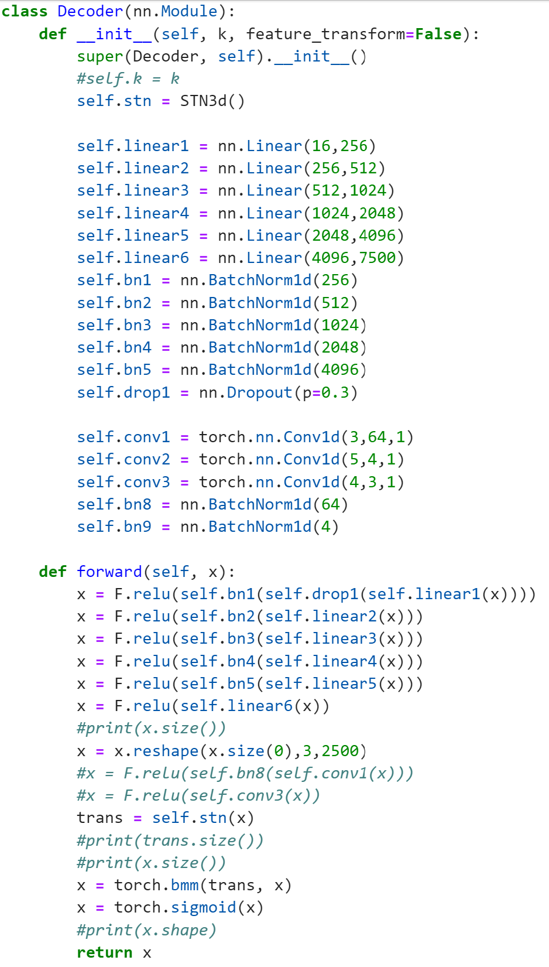
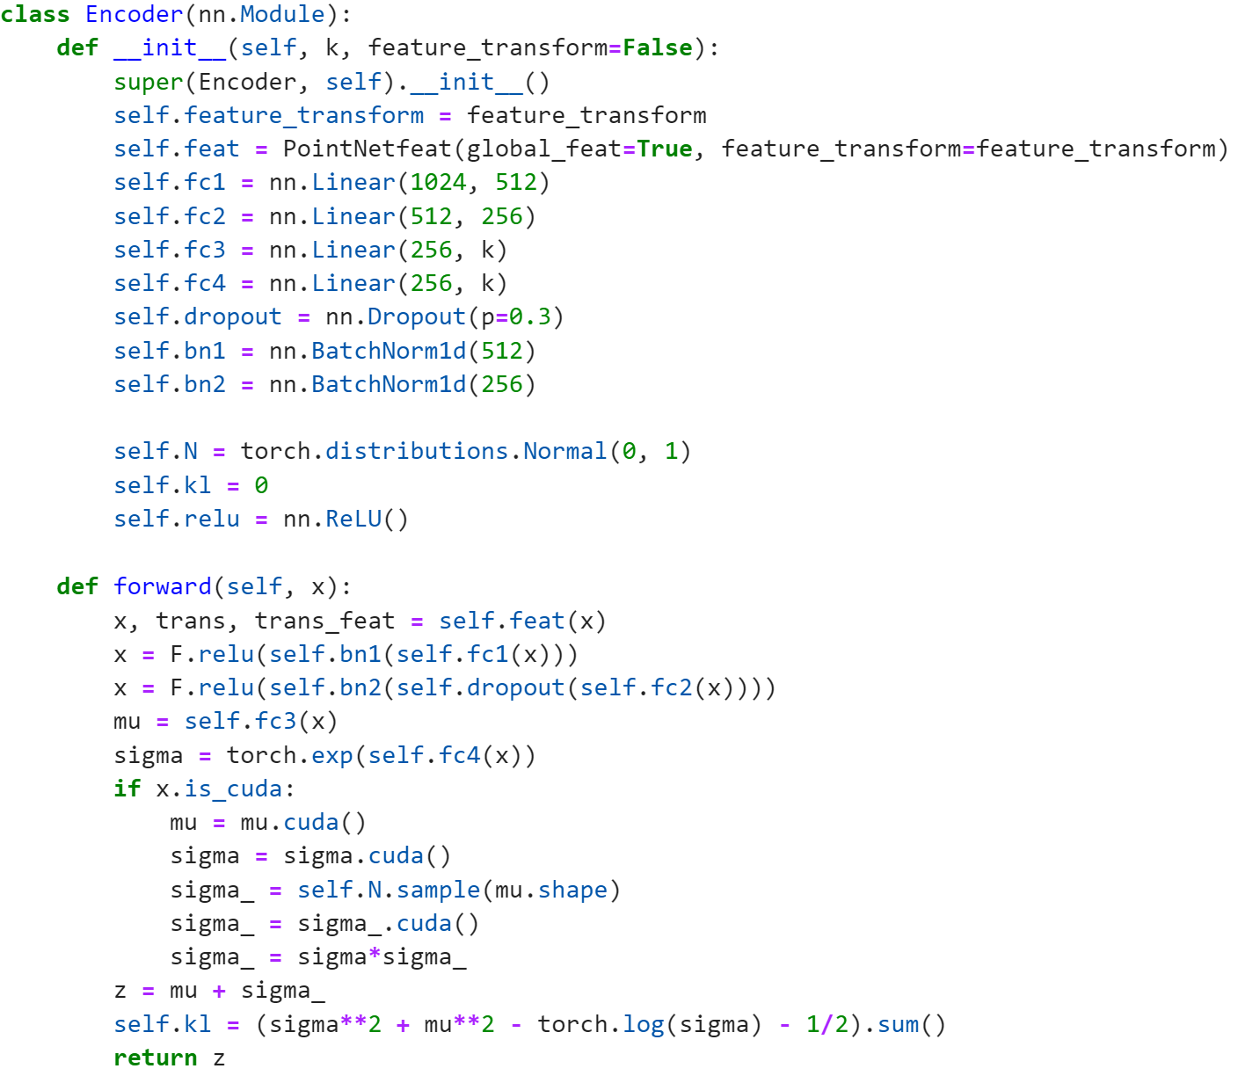
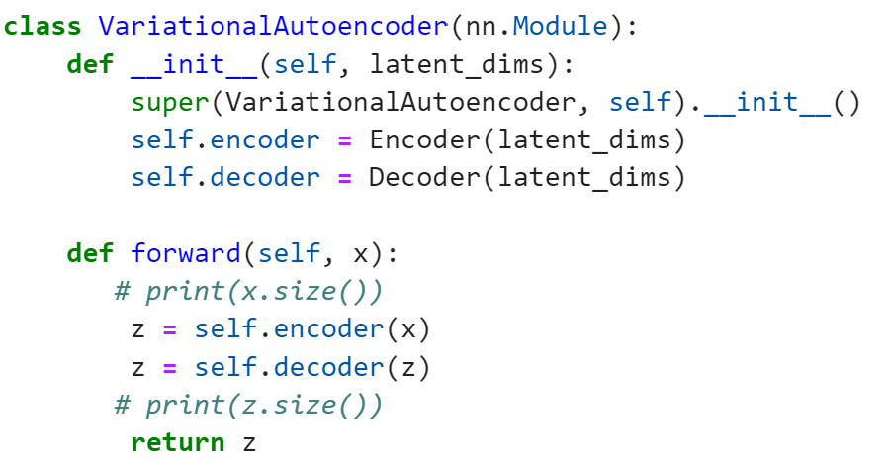
VAE
Reversed engineered the classification model to write the decoder
Alter the classification model to be used as an encoder

Slide 4
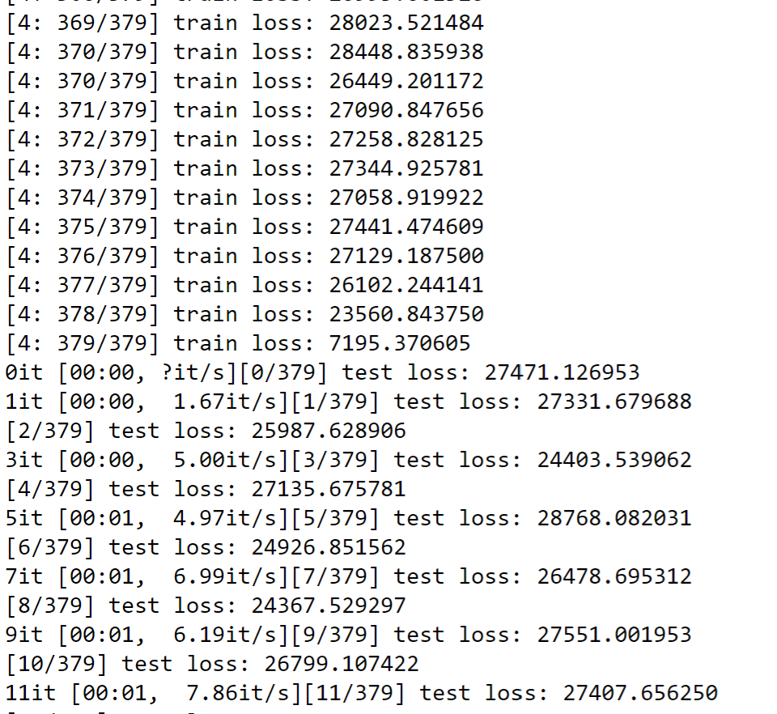

Results
The test and train loss are little too high right now
Research ongoing to improve the model

Slide 5
Future Work
Trying to figure out how display the point clouds – newly generated and original images

